Slide 1
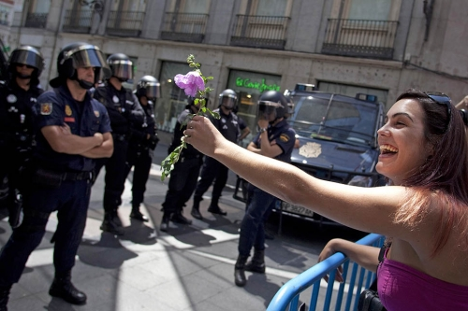
GANDHIAN PHILOSOPHY TRUTH AND NON-VIOLENCE

Slide 2
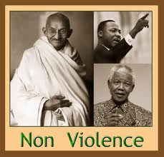

Slide 3
WHAT IS GANDHIAN PHILOSOPHY
It is the religious and social ideas adopted and developed by Gandhi, first during his period in South Africa from 1893 to 1914, and later in India.
The twin cardinal principles of Gandhi's thought are Satyagraha (truth) and Ahimsa (nonviolence).
He also believed in Sarvodaya (or upliftment of all)

Slide 4
AHIMSA
The concept of nonviolence (ahimsa) and nonresistance has a long history in Indian religious thought and has had many revivals in Hindu, Buddhist, Jain and Christian contexts.
"An eye for an eye makes the whole world blind."

Slide 5
AHIMSA
Ahimsa, far from meaning mere peacefulness or the absence of overt violence, is understood by Gandhi to denote active love - the pole opposite of violence, or "himsa", in every sense.
Conflict may be inevitable but violence is not.

Slide 6

MEANS TO THE END
Means to achieving a goal are as important as the goal itself “There are many causes that I am prepared to die for but no causes that I am prepared to kill for”.
Means of satyagraha – non-cooperation and fasting, marches, demonstrations, boycotts, and strikes.

Slide 7
TOLERANCE
“I have never understood how any man can derive pleasure from the humiliation of another”.
“A satyagrahi must never forget the distinction between evil and the evil – doer”.

Slide 8
ON TRUTH
Truth is the law of our being. The ties of love binds
all. Nothing could have existed without a centripetal
force. Scientist tell us, that without the presence of
the cohesive force among the atoms that comprise
this globe of ours, it would cease to exist, and even
as there is cohesive force in blind matter, so much
there be in all things animate and the name of that
cohesive force among all animate beings is love.’

Slide 9
CHALLENGES FACING THE WORLD TODAY
Terrorism
Economic disparities
Threat of environmental degradation and climate change
Diseases like HIV-AIDS.

Slide 10
ECONOMIC DIAPARITIES
Observing the rush to consumerism that is so evident today, Mahatma Gandhi would likely have reminded us that a modicum of austerity would not be out of place.
Gandhian principle of simplicity - Once, reacting to criticism that he was wearing merely his usual loin cloth, sandals and shawl when invited to tea by King George and Queen Mary, he said, "The King had enough on for both of us."

Slide 11
TERRORISM AND INTOLERANCE
When asked about his religious belief, he said, "yes I am a Hindu. I am also a Christian, a Muslim, a Buddhist and a Jew".
If democracies are going to wage a war against terrorism, the measures that are adopted, should be consistent with and not contrary to the values of democracy. This is in keeping with the Gandhian consonance of ends and means.

Slide 12
EXAMPLES OF NON VIOLENT RESISTANCE IN THE WORLD
American colonists conducted three strategically planned nonviolent struggle campaigns against British regulations, taxation, and rule from 1765 to 1775.
Chinese boycotts of Japanese products occurred in 1908, 1915, and 1919.
From 1940 to 1945 in various European countries, especially in Norway, Denmark, and the Netherlands, the populations used nonviolent struggle to resist Nazi occupation and fascist rule.

Slide 13
EXAMPLES OF NON VIOLENT RESISTANCE IN THE WORLD
The American civil rights struggles against racial segregation and discrimination, especially in the 1950s and 1960s, with the participation of Dr. Martin Luther King, Jr. and many others changed laws and long established segregation policies, especially in the United States South
In South Africa nonviolent protests and mass resistance were highly important in undermining the Apartheid policies and European domination, especially between 1950 and 1990

Slide 14
WHY IT DOESN’T NON – VIOLENCE ALWAYS WORK
The nonviolent resisters have not anticipated the brutalities inflicted by their opponents so that they not only suffered gravely but also sometimes the resistance collapsed.
Planning, lack of carefully developed strategy, and unwise actions and use of resources, have reduced the chances of success in many past nonviolent struggles.

Slide 15
WHAT DOES NON – VIOLENCE REQUIRE
Understanding
Courage
Tenacity
Discipline
Organizational capacity, and
Great strategic skill.

Slide 16
EXAMPLES OF GANDHIAN PHILOSOPHY IN EVERYDAY LIVES
Kusuma Rajaiah, inventor of Ahimsa Silk
Rina Shah, shoe designer

